Slide 1
PRESENTATION muqeet
FORMS AND REPORTS

Slide 2
CONTENTS
FORMS
REPORTS
RELATIONSHIPS
EXAMPLES

Slide 3
FORMS
Forms are user interface objects that allow users to interact with data in a database.
Forms can be used to display, enter, edit, and delete data, as well as perform other tasks such as searching and filtering.

Slide 4
TYPES OF FORMS
Detail forms:
Display one record at a time and allow users to edit or delete the record.
Summary forms:
Display a summary of data from multiple records, such as a list of all customers in a state or a report of all sales for a month.
Pivot tables:
Display data in a tabular format that can be easily sorted and filtered.
Sub forms:
Display related data from another table or query in a subordinate form.

Slide 5
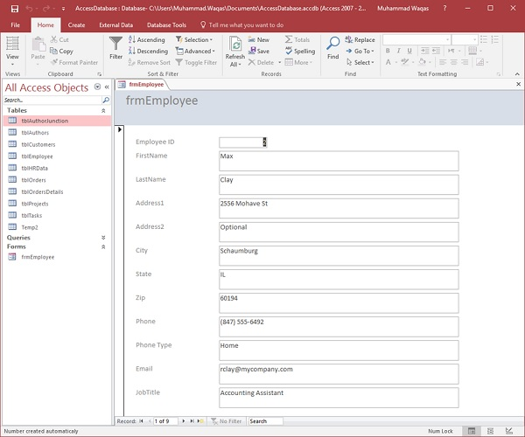
EXAMPLE OF SINGLE ITEM FORM

Slide 6
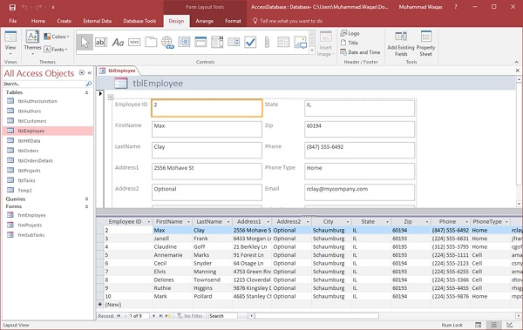
EXAMPLE OF SPLIT FORM

Slide 7
BENEFITS OF FORMS
Improved data entry accuracy:
Forms can help to improve data entry accuracy by providing users with a structured way to enter data.
increased efficiency:
Forms can help users to work more efficiently by providing them with quick and easy access to the data they need.
Enhanced usability:
Forms can make database applications more user-friendly by providing a more intuitive and visually appealing interface.
Improved security:
Forms can be used to implement security measures to control who has access to data and what changes they can make.

Slide 8
REPORTS
Reports are objects that are used to display data in a formatted and organized way.
Reports can be used to generate a variety of output, including printed reports, PDFs, and email attachments.
Reports are typically based on a table or query, and they can include fields from multiple tables
Reports can also be used to create custom calculations and formatting.
For example,
a report could be used to calculate the total sales for each product category or to create a bar chart of customer demographics.

Slide 9
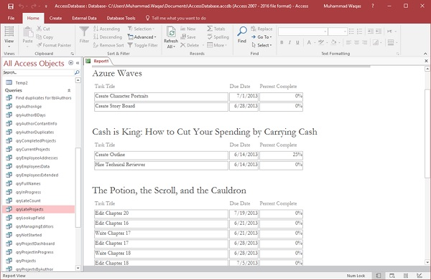
EXAMPLE OF REPORTS

Slide 10
BENIFETS OF REPORTS
Improved data visualization:
Reports can be used to create visually appealing and informative reports that can help users to understand their data.
Increased productivity:
Reports can help users to be more productive by providing them with quick and easy access to the information they need.
Enhanced collaboration:
Reports can be shared with others, which can help to improve communication and collaboration within an organization.
Improved compliance:
Reports can be used to generate reports that are required by law or regulation.

Slide 11
RELATIONSHIPS
Relationships i used to connect data from two or more tables.
This allows users to query and report on data from multiple tables as if it were all in one table.

Slide 12
TYPES OF RELATIONSHIP
One-to-many:
This is the most common type of relationship.
It represents a situation where one record in one table can be related to many records in another table, but each record in the second table can only be related to one record in the first table.
Many-to-many:
This type of relationship represents a situation where many records in one table can be related to many records in another table.
To implement a many-to-many relationship, a third table is needed to act as a bridge between the two tables.
One-to-one:
This type of relationship represents a situation where each record in one table is related to exactly one record in another table.
This type of relationship is less common than one-to-many and many-to-many relationships.

Slide 13
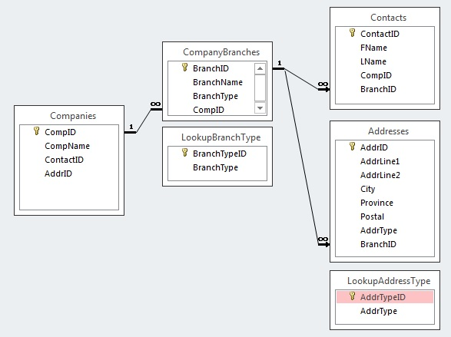
ONE TO MANY EXAMPLE

Slide 14
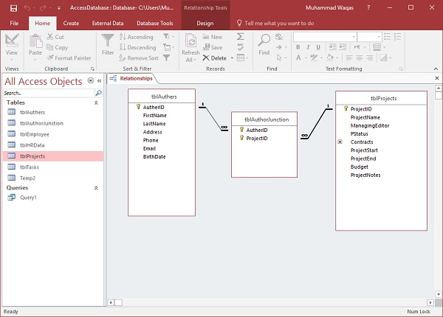
MANY TO MANY EXAMPLE

Slide 15
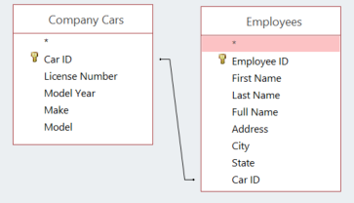
ONE TO ONE EXAMPLE

Slide 16
THANKS

